Slide 1


GUVI CAPSTONE PROJECT
TITLE: CRAFTING COMPELLING WEB PRESENCES
DEEPIKA ANANTHAN
MBM6

Slide 2

ITC
Enduring value

Slide 3
1. ITC PRODUCTS
2. PLATFORM ON WHICH THE WEBSITE
IS DEVELOPED
3. TESTING THE WEBSITE
4. WEBSITE DESIGN MISTAKES TO AVOID
5. PRACTICES FOR CREATING VISUALLY
APPEALING AND USER-FRIENDLY
WEBSITE DESIGNS.
6. LANDING PAGE OF ITC
CONTENT
VIEW
VIEW
VIEW
VIEW
VIEW
VIEW

Slide 4

ITC PRODUCTS
PERSONAL CARE EDUCATION
FOOD
MATCHES & AGARBATTI
FIAMA
CLASSMATE
MANGALDEEP
KITCHENS OF INDIA

Slide 5

KITCHENS OF INDIA
Authentic Indian Cuisine: Offers a diverse range of ready-to-eat Indian gourmet dishes crafted with authentic recipes passed down through generations.
High-Quality Ingredients: Emphasizes the use of premium ingredients sourced from across India to ensure the authenticity and flavor of each dish.
Convenient Dining: Provides a convenient way for consumers to enjoy authentic Indian cuisine at home, maintaining the integrity of traditional recipes while offering ease of preparation.

Slide 6
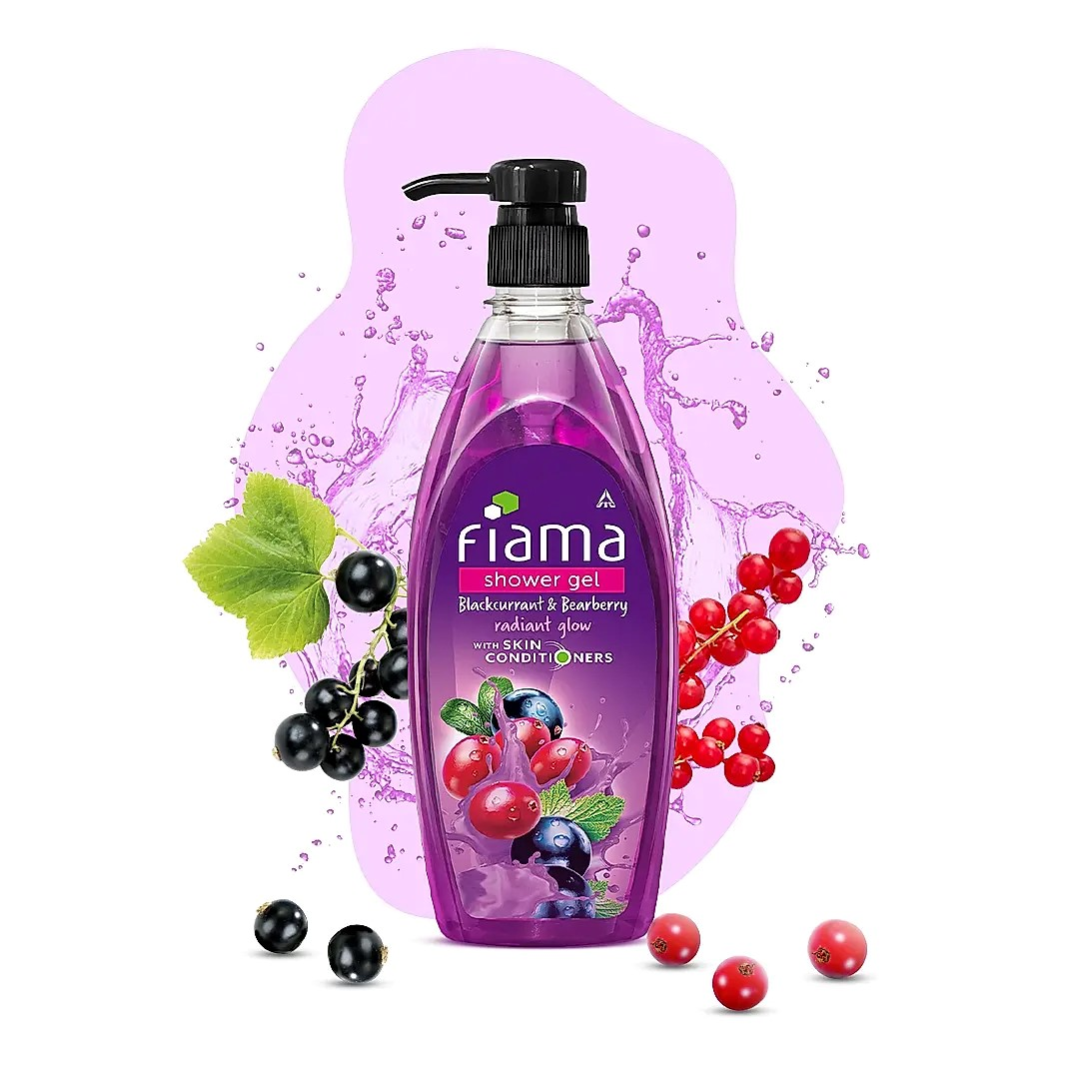
FIAMA
Fiama offers a range of innovative personal care products designed to enhance the bathing experience and promote overall well-being.
The brand emphasizes advanced formulations enriched with natural ingredients and cutting-edge technology to deliver effective and luxurious skincare solutions.
Fiama products are crafted to provide a sensory experience, combining delightful fragrances, luxurious textures, and indulgent ingredients to elevate the bathing ritual.

Slide 7

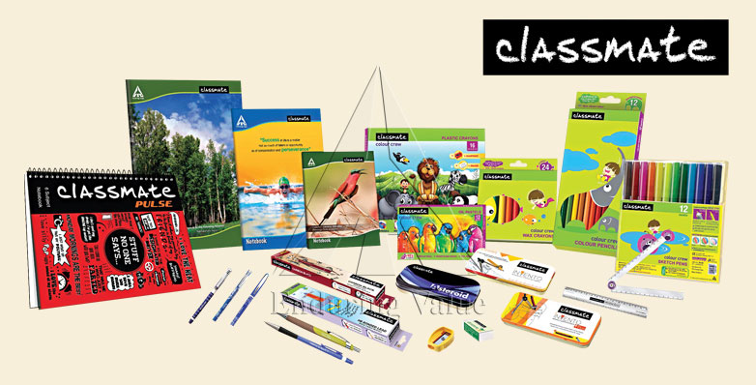
EDUCATION
Classmate provides a wide range of school and office stationery products, including notebooks, pens, pencils, and art supplies, essential for students and professionals alike.
The brand is known for its commitment to quality and durability, ensuring that its products withstand the rigors of daily use and provide a reliable platform for learning and creativity.
Classmate continuously innovates its product offerings to meet the evolving needs of its consumers, while also prioritizing sustainability initiatives to minimize environmental impact across its supply chain.

Slide 8
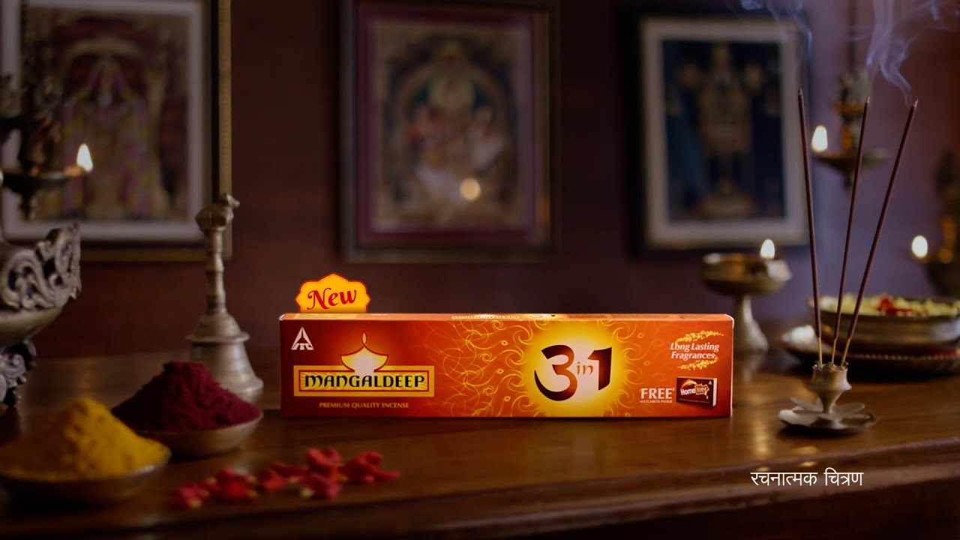
MANGALDEEP
Spiritual Offerings: Mangaldeep offers a range of spiritual products such as agarbattis (incense sticks), dhoop cones, and puja essentials, catering to the spiritual needs of consumers across India.
Authentic Fragrances: The brand is known for its authentic fragrances crafted from a blend of natural ingredients, creating a serene and uplifting atmosphere during religious ceremonies and daily rituals.
Tradition and Heritage: Mangaldeep products are deeply rooted in Indian tradition and heritage, reflecting the rich cultural diversity of the country and providing a connection to spirituality for millions of people.

Slide 9



PLATFORM ON WHICH THE WEBSITE IS DEVELOPED
TOOL
WAPPALYZER

Slide 10
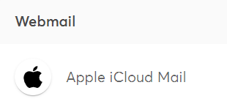
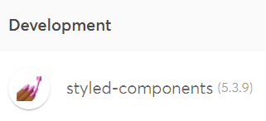
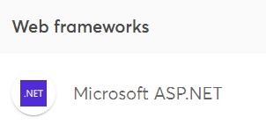
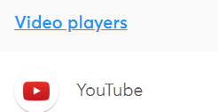
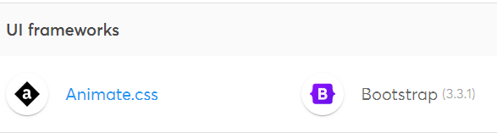
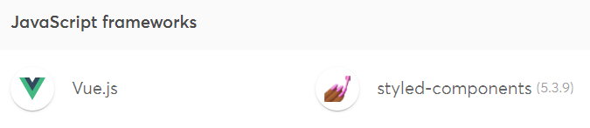
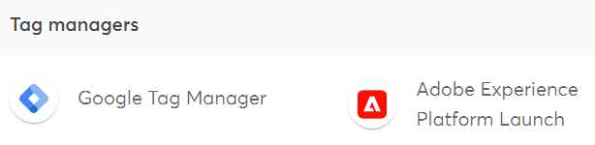
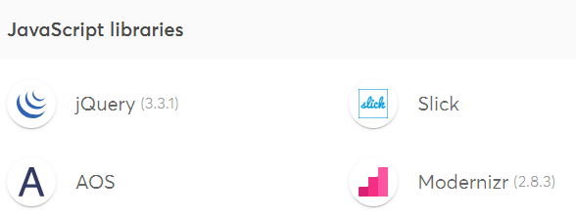

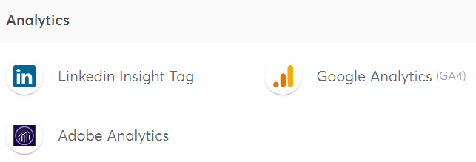

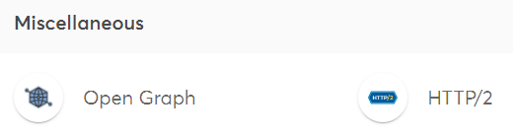
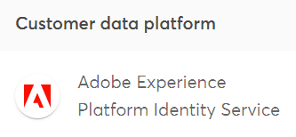
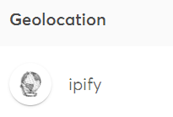
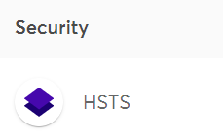

Slide 11
The primary platform for building the ITC web framework is Microsoft ASP.NET. Alternatively, they used CSS, JavaScript and backend technology like Node.JS
TOOL
WAPPALYZER

Slide 12

TESTING THE WEBSITE
HOME ITC INFOTECH BRANDWORLD ITC BUSINESS CAREERS
TOOL USED:GOOGLE CHROME DEVTOOLS
TABLET VIEW
PHONE VIEW
DESKTOP VIEW
LAPTOP VIEW

Slide 13
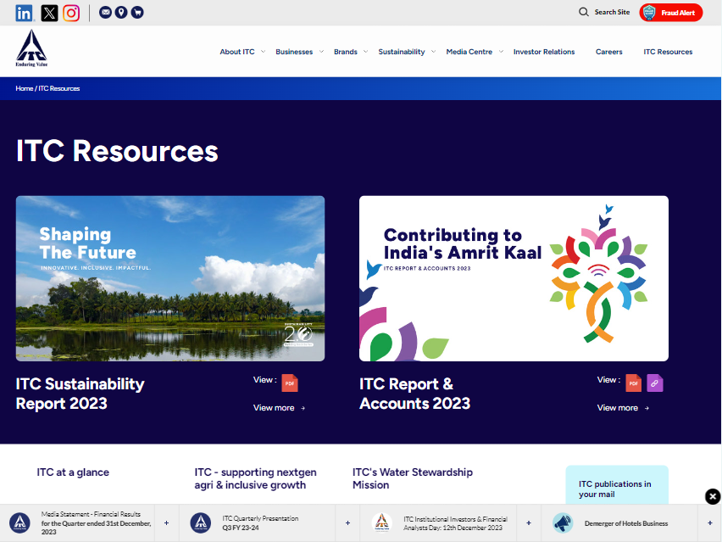
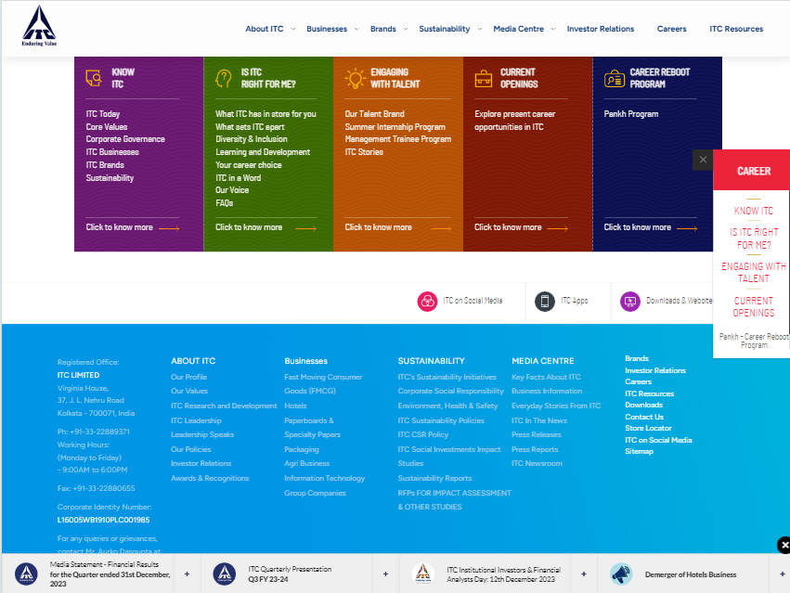
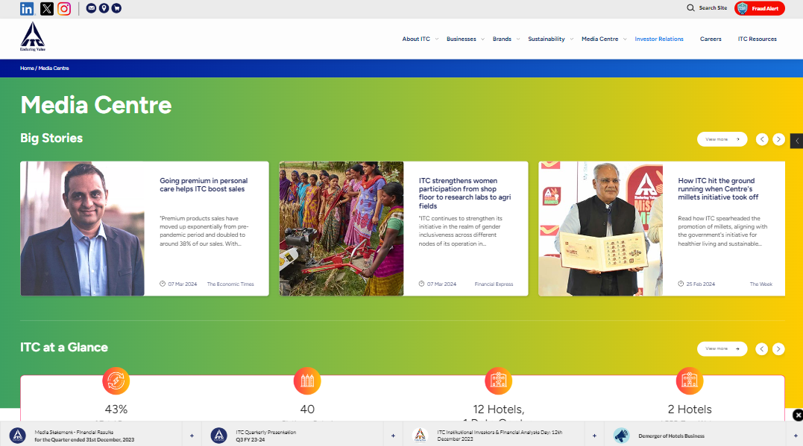
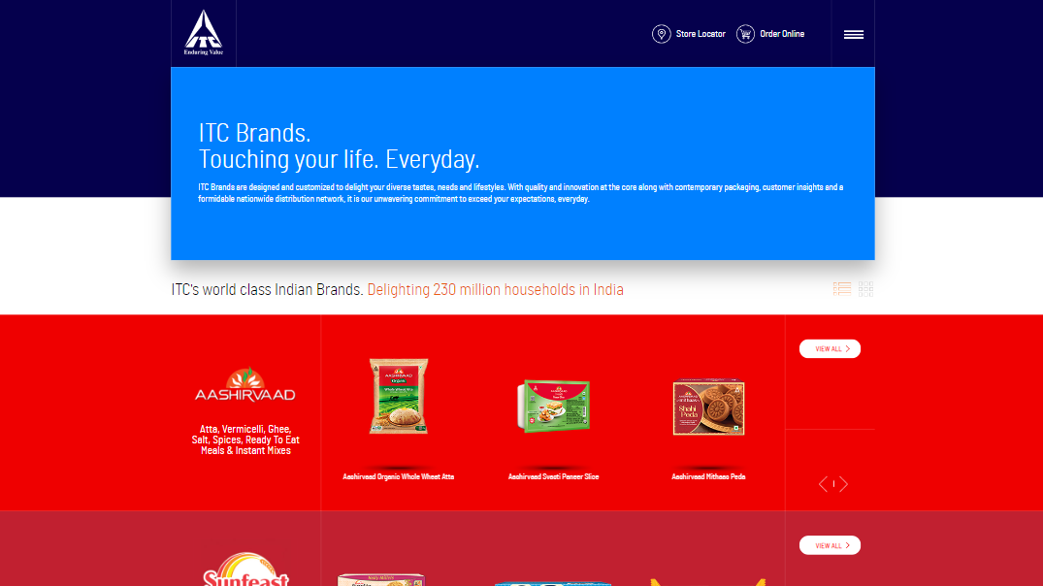
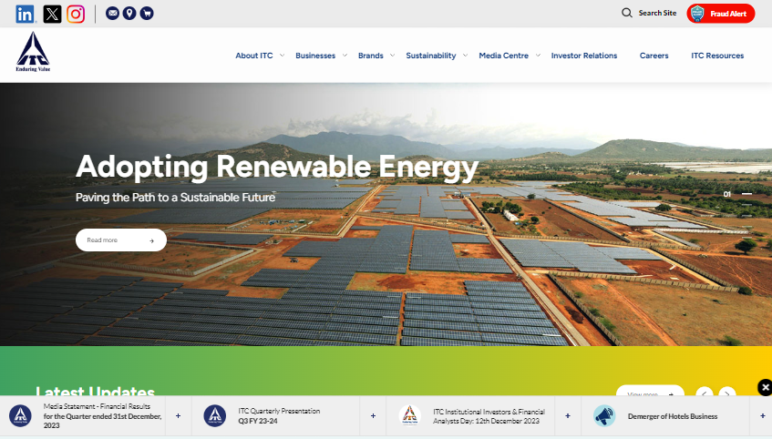
TABLET VIEW-1024*768

Slide 14
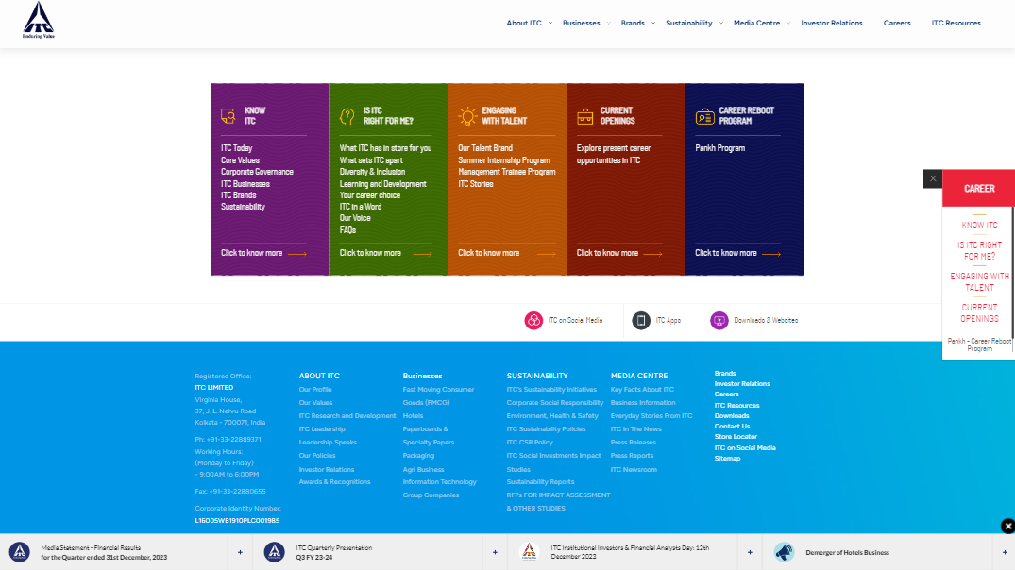
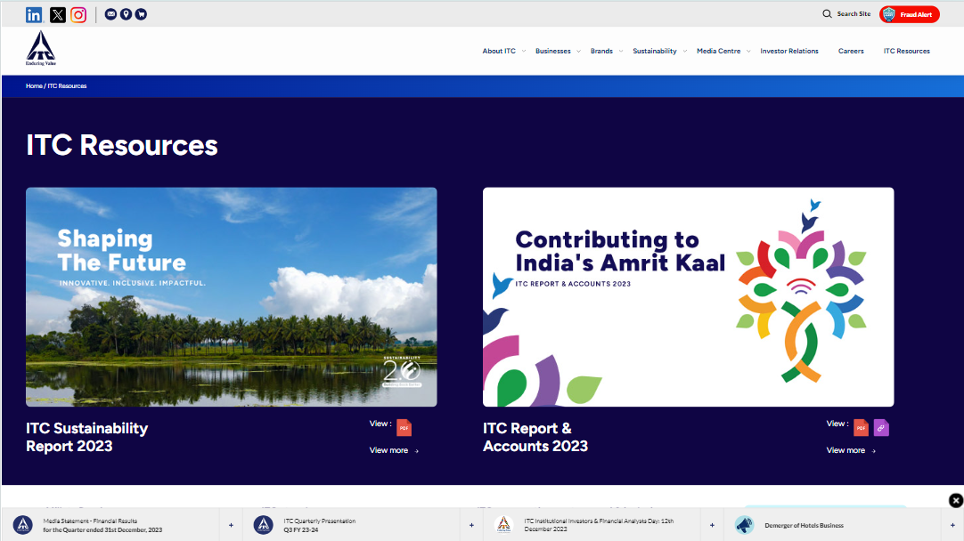
DESKTOP VIEW-1920*1080

Slide 15
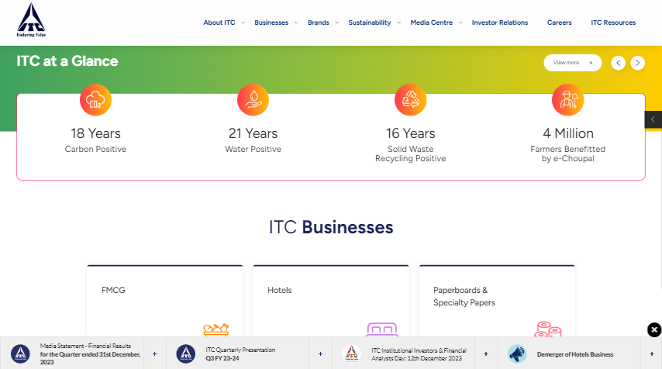
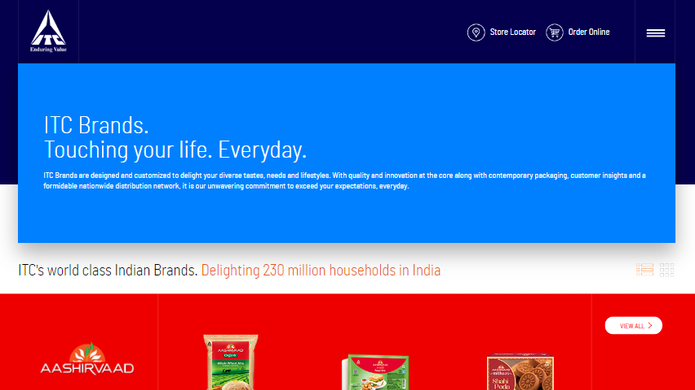
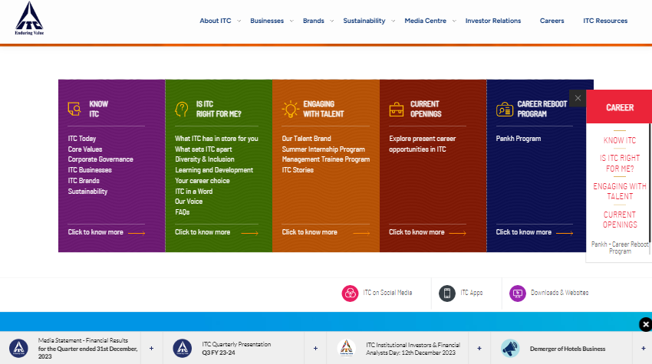
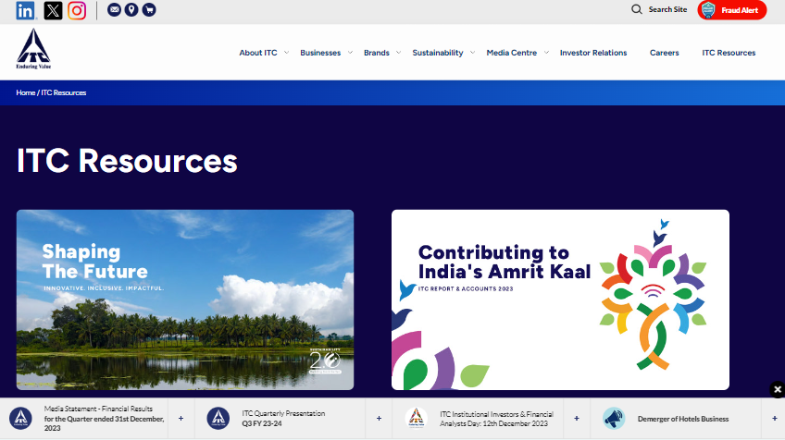
LAPTOP VIEW-1366*768

Slide 16
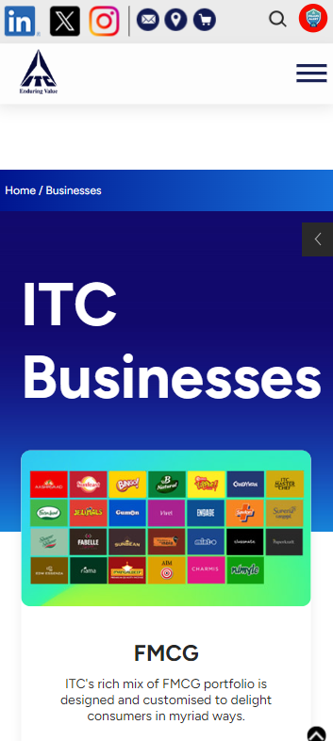
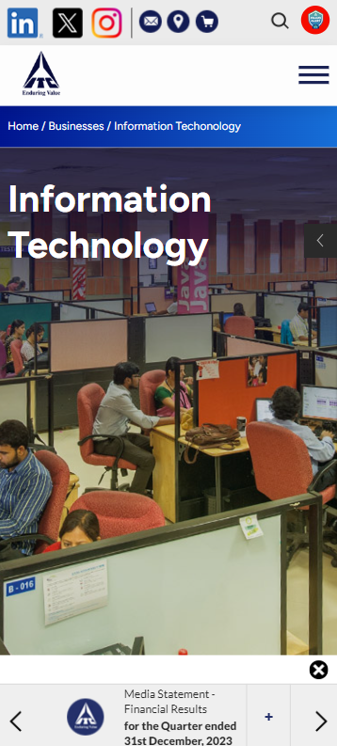
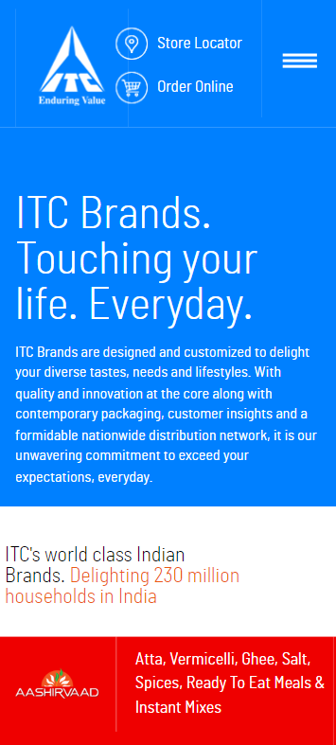
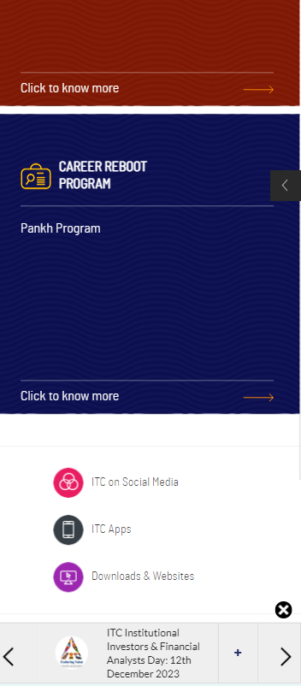
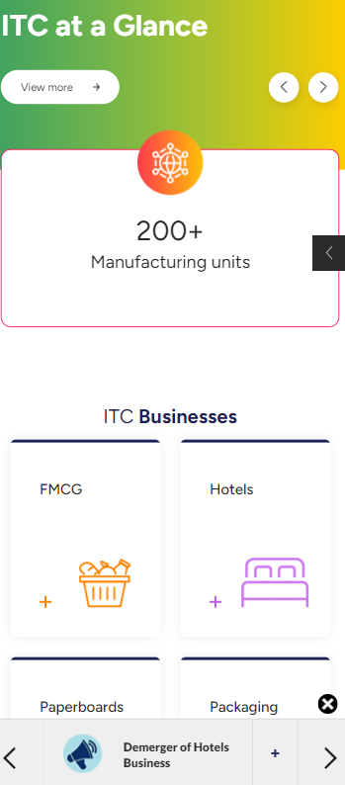
PHONE VIEW-390*844

Slide 17

WEBSITE DESIGN MISTAKES TO AVOID
SLOW LOADING SPEED
NON RESPONSIVE WEB DESIGN
SPACING IN WEBSITE

Slide 18
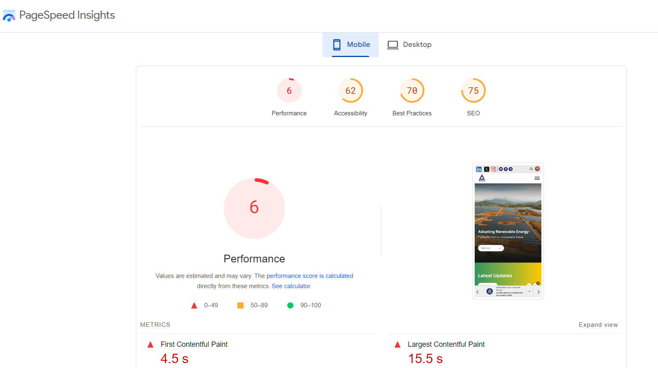
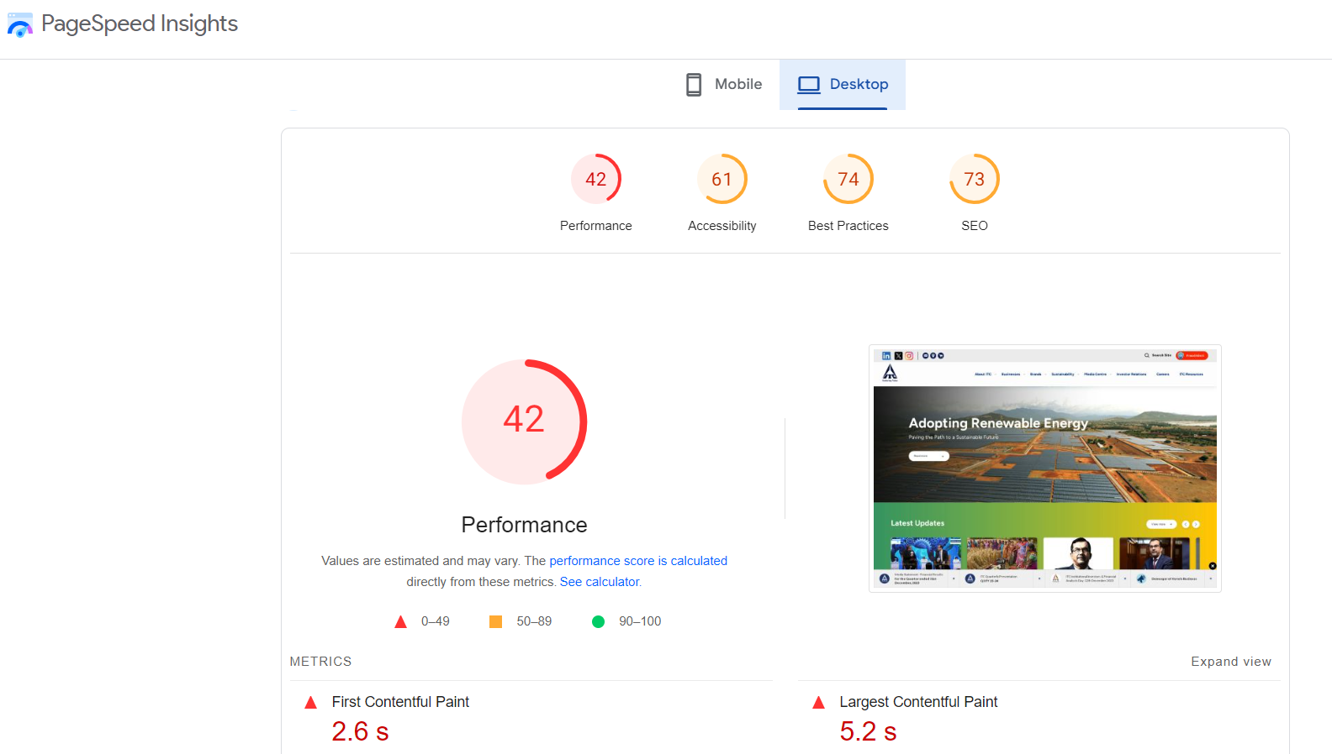
SLOW LOADING SPEED: RESULT LEAD TO POOR USER EXPERIENCE
TO AVOID THIS: OPTIMIZE THE MEDIA FILES BY COMPRESSING IMAGES AND VIDEOS.MINIMIZE THE USE OF HEAVY SCRIPTS AND FLASH CONTENT THAT CAN SLOW DOWN PAGE RENDERING

Slide 19
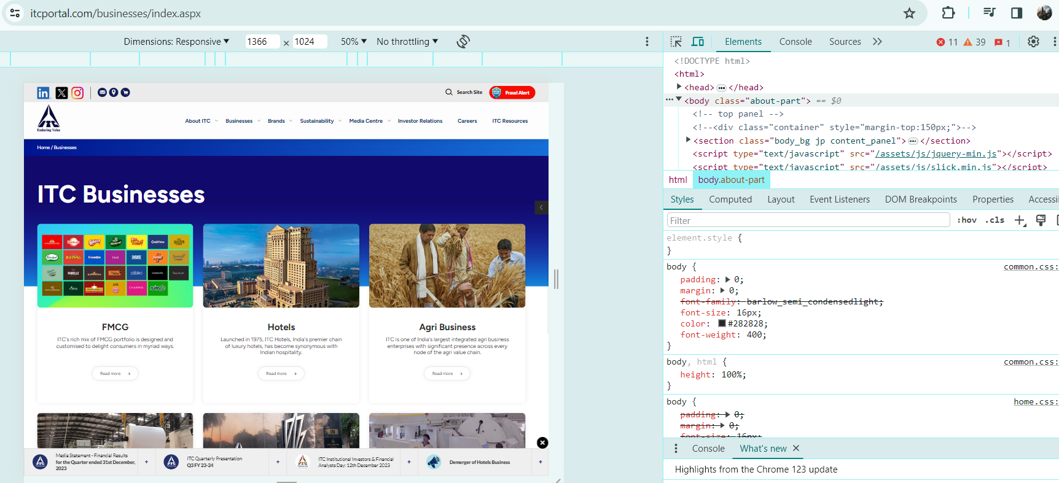
NON RESPONSIVE WEB DESIGN
AS WE CHANGE THE SIZE AND POSITION ,THE DOWN ARROW OPTION OF WEBSITE DOESN’T WORKS PROPERLY. SO THE USER CANN’T GET ADDITIONAL CONTENT BELOW.

Slide 20
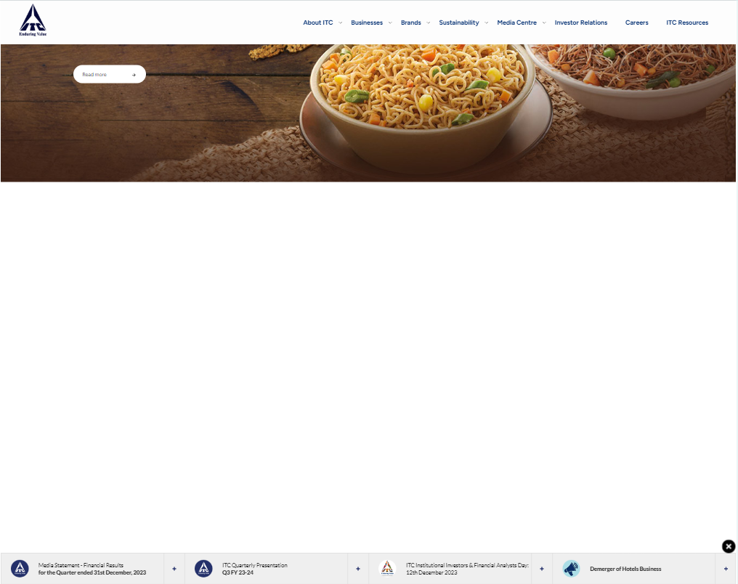
S
SPACING
BLANK SPACING IN THE LAYOUT, THE REACHING CONTENT IN DOWN TAKES TIME AND BACK TO TOP BUTTON DOES NOT AVAILABLE SO HAVE TO SCROLL MORE PAGES TO BE TOP

Slide 21


PRACTICES FOR CREATING VISUALLY APPEALING AND USER-FRIENDLY WEBSITE DESIGNS

Slide 22

Reflect ITC's Brand Identity: Ensure that the website design aligns with ITC's brand identity, including its logo, colors, typography, and imagery. Consistency in branding elements helps reinforce brand recognition and trust.
Highlight ITC's Products and Services: Showcase ITC's diverse range of products and services prominently on the website. Use high-quality images, descriptive text, and interactive elements to engage visitors and highlight the unique selling points of each product or service.
Emphasize Sustainability and Social Responsibility: Given ITC's focus on sustainability and social responsibility, incorporate elements that highlight its initiatives in these areas. Feature content about ITC's sustainability practices, community engagement, and corporate social responsibility efforts to communicate its values to visitors.
Accessibility and Inclusivity: Ensure that the website design complies with accessibility standards and guidelines to accommodate users with disabilities. Provide alternative text for images, captions for videos, and keyboard navigation options to ensure inclusivity for all visitors.

Slide 23
User-Centric Design: Prioritize user experience by designing the website with the needs and preferences of ITC's target audience in mind. Conduct user research to understand their motivations, points, and browsing behaviors, and tailor the website navigation, content organization, and interactive features accordingly.
Interactive Features: Implement interactive features such as product configurators, virtual tours, or interactive maps to engage visitors and provide immersive experiences. These features can help showcase ITC's products and services in a dynamic and memorable way.
Multi-Language Support: If ITC operates in multiple regions or serves a diverse customer base, consider implementing multi-language support on the website to cater to different language preferences and enhance accessibility for international visitors.
Integration with Social Media: Integrate social media feeds, sharing buttons, and user-generated content into the website to encourage engagement and amplify ITC's online presence. Showcase user testimonials, reviews, and social media posts to build credibility and trust.

Slide 24

LANDING PAGE OF ITC
https://deepikaananthan24.my.canva.site/landing-page-for-itc

Slide 25






THANK YOU

